Slide 1
Weekly Update Concept Erasing on UMM
2026.01.02
Hayeon Jeong

Slide 2
Table of Contents
CVPR 2026
UMM Unlearning
Plan
Where to update?
EraseAnything 논문처럼 - self-attention 부분을 heatmap으로 그려보기
SPEED 방법을, W_k, W_v에 적용해보기 (구현) → 발생하는 문제점 찾기

Slide 3
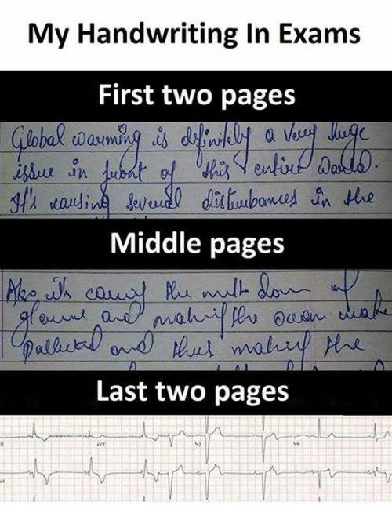

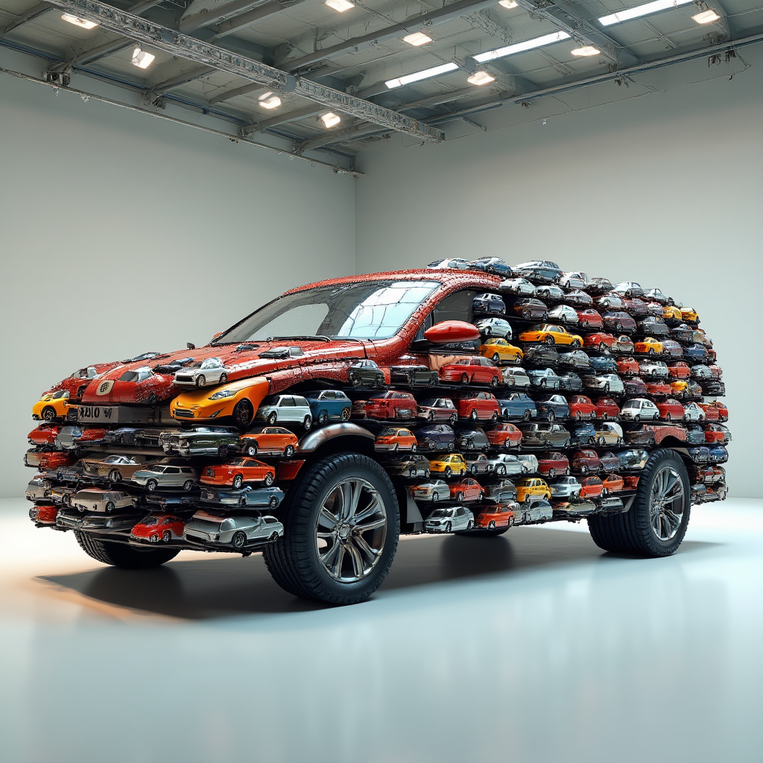
What BAGEL can do?
Image generation +with think
Image Editing +with think
Text generation (Understanding)
A female cosplayer portraying an ethereal fairy or elf, wearing a flowing dress made of delicate fabrics in soft, mystical colors like emerald green and silver. She has pointed ears, a gentle, enchanting expression, and her outfit is adorned with sparkling jewels and intricate patterns. The background is a magical forest with glowing plants, mystical creatures, and a serene atmosphere."
“a car made of small cars”
The humor in this meme comes from the exaggerated change in handwriting style as the exam progresses. At the beginning, the handwriting is clear and legible, indicating a confident and well-prepared student. However, as the exam continues, the handwriting becomes increasingly difficult to read, suggesting that the student is becoming more anxious and less focused. The final part of the meme shows an electrocardiogram (ECG) reading, which humorously implies that the student's heart rate is racing due to stress, further emphasizing the comedic contrast between the initial calm and the final chaos.

Slide 4
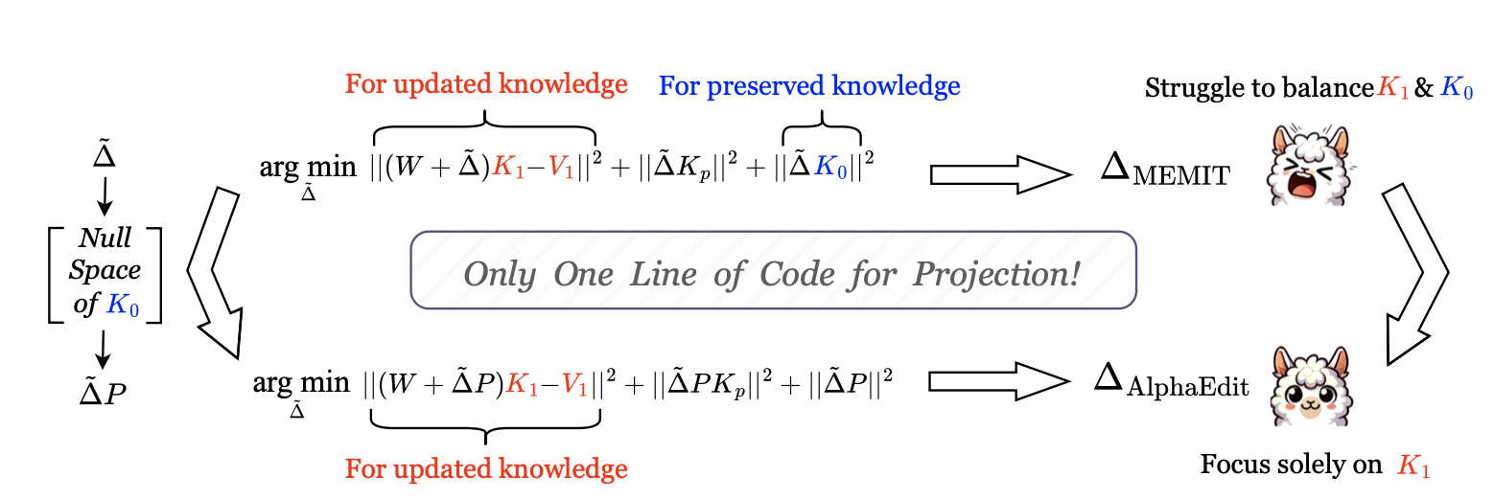
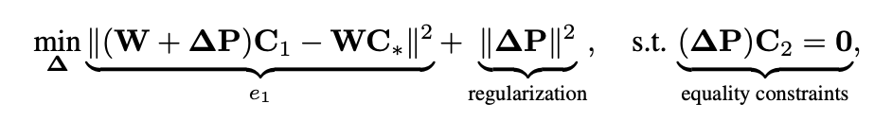

Concept Erasing
Preservation (어떻게 잘 보존할 것인가)
AlphaEdit: Null-Space Constrained Knowledge Editing for Language Models (CVPR, 2025)
AlphaEdit는 Transformer FFN이 memory 역할을 한다는 ACL 2021 분석에 기반함
ReLU 활성화가 특정 지식 패턴을 담당한다는 관찰로부터 FFN을 editing 대상으로 삼음
SPEED: Scalable, Precise, and Efficient Concept Erasure for Diffusion Models (ICLR, 2026)
AlphaEdit의 null space projection 아이디어를 diffusion 모델로 확장
Stable Diffusion에서 W_k, W_v를 수정 대상으로 삼아 concept erasing
“어디를 고쳐야 preservation이 되는가”를 구조적으로 재정의

Slide 5
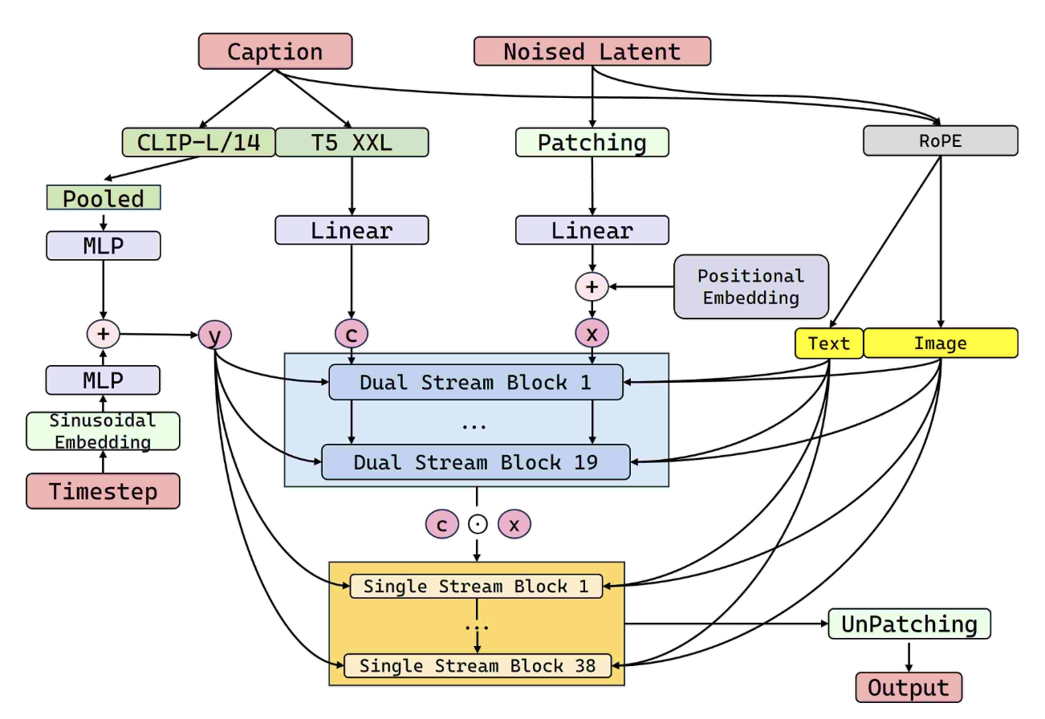
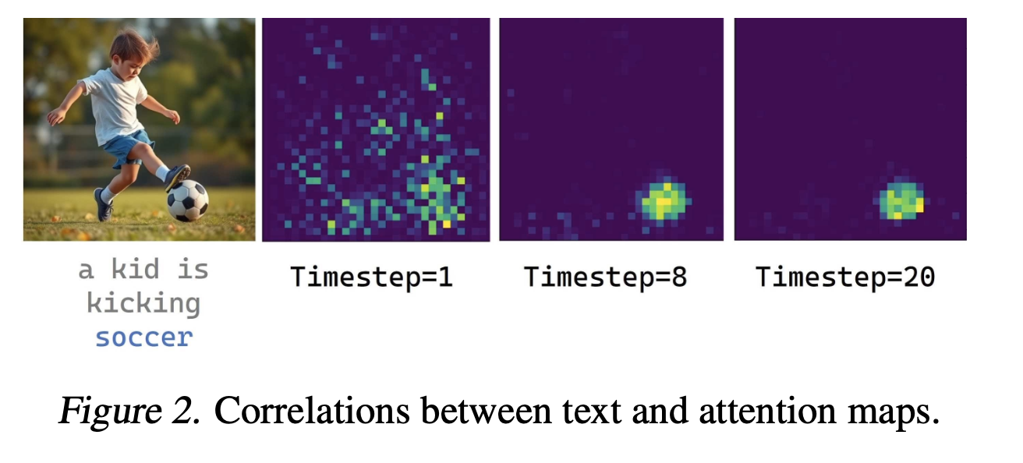
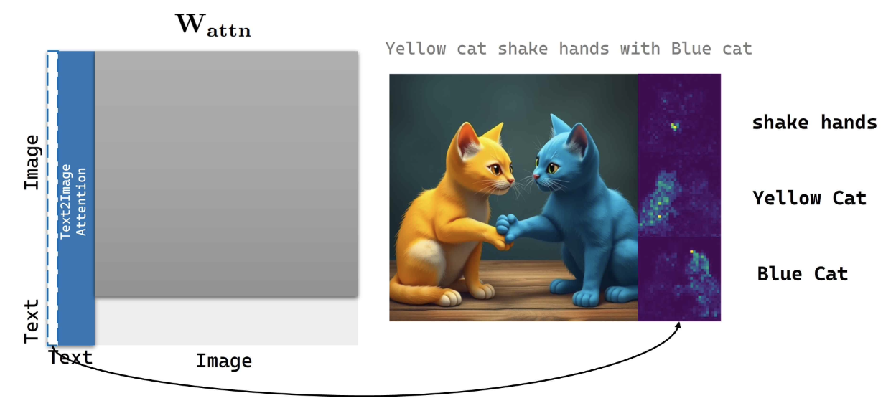
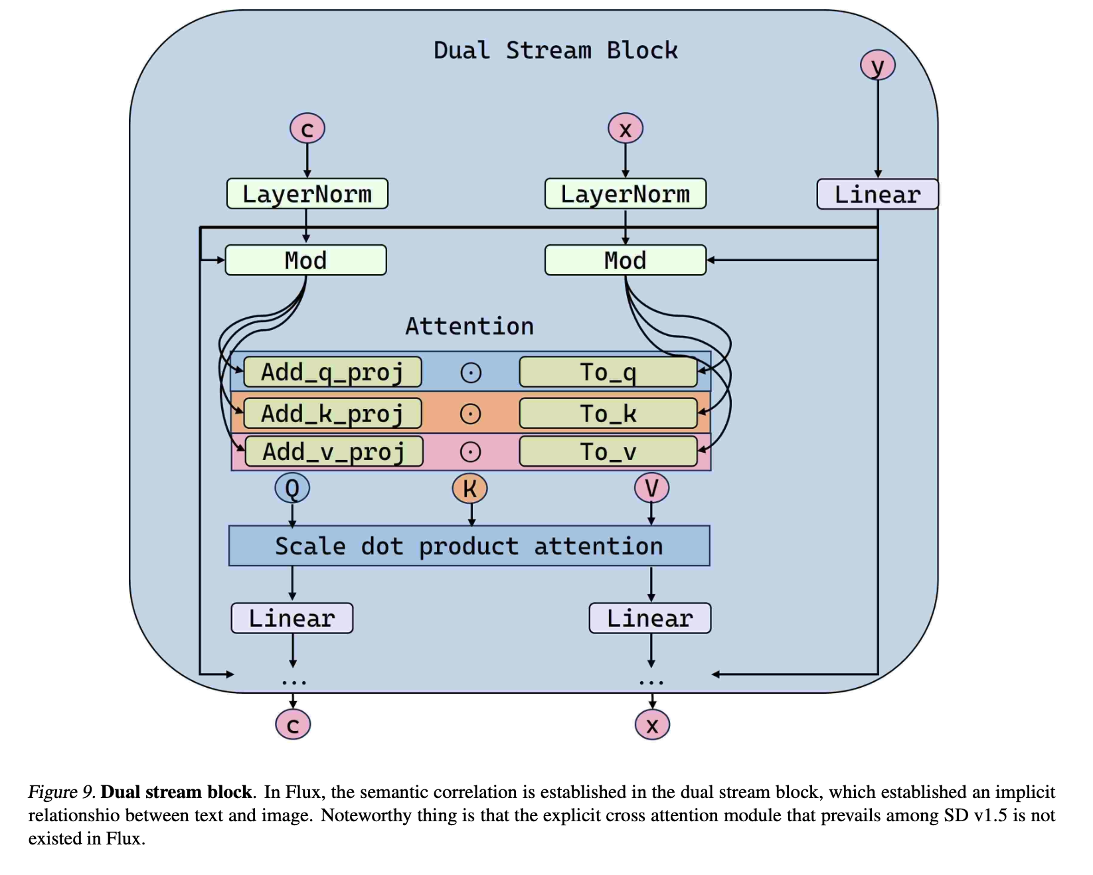
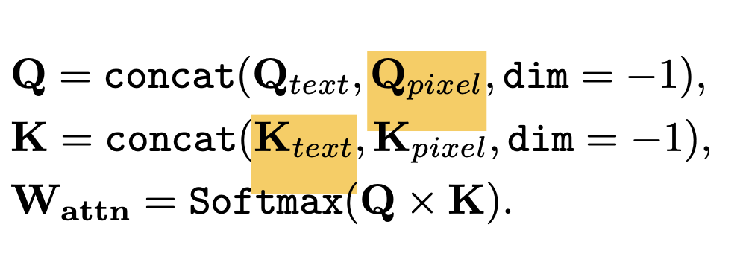
Concept Erasing
FLUX 모델에서의 concept erasing
EraseAnything: Enabling Concept Erasure in Rectified Flow Transformers (ICML, 2025)
Minimalist Concept Erasure in Generative Models (ICML, 2025)

Slide 6
Experiment
BAGEL model’s Q-K attention map
Q: 프롬프트 토큰들(76개) + <|vision_start|>(1개)] + VAE Latent 토큰들(4096개) + <|vision_end|>(1개)
K: 프롬프트 토큰들(76개) + <|vision_start|>(1개)] + VAE Latent 토큰들(4096개) + <|vision_end|>(1개)
txt
(Thinking mode)
Understanding
Generation
Editing
img
txt
img

Slide 7
Experiment
BAGEL model’s Q-K attention map
Q: 프롬프트 토큰들(76개) + <|vision_start|>(1개)] + VAE Latent 토큰들(4096개) + <|vision_end|>(1개)
K: 프롬프트 토큰들(76개) + <|vision_start|>(1개)] + VAE Latent 토큰들(4096개) + <|vision_end|>(1개)
txt
(Thinking mode)
Understanding
Generation
Editing
img
(4096=64x64)
txt
img

Slide 8

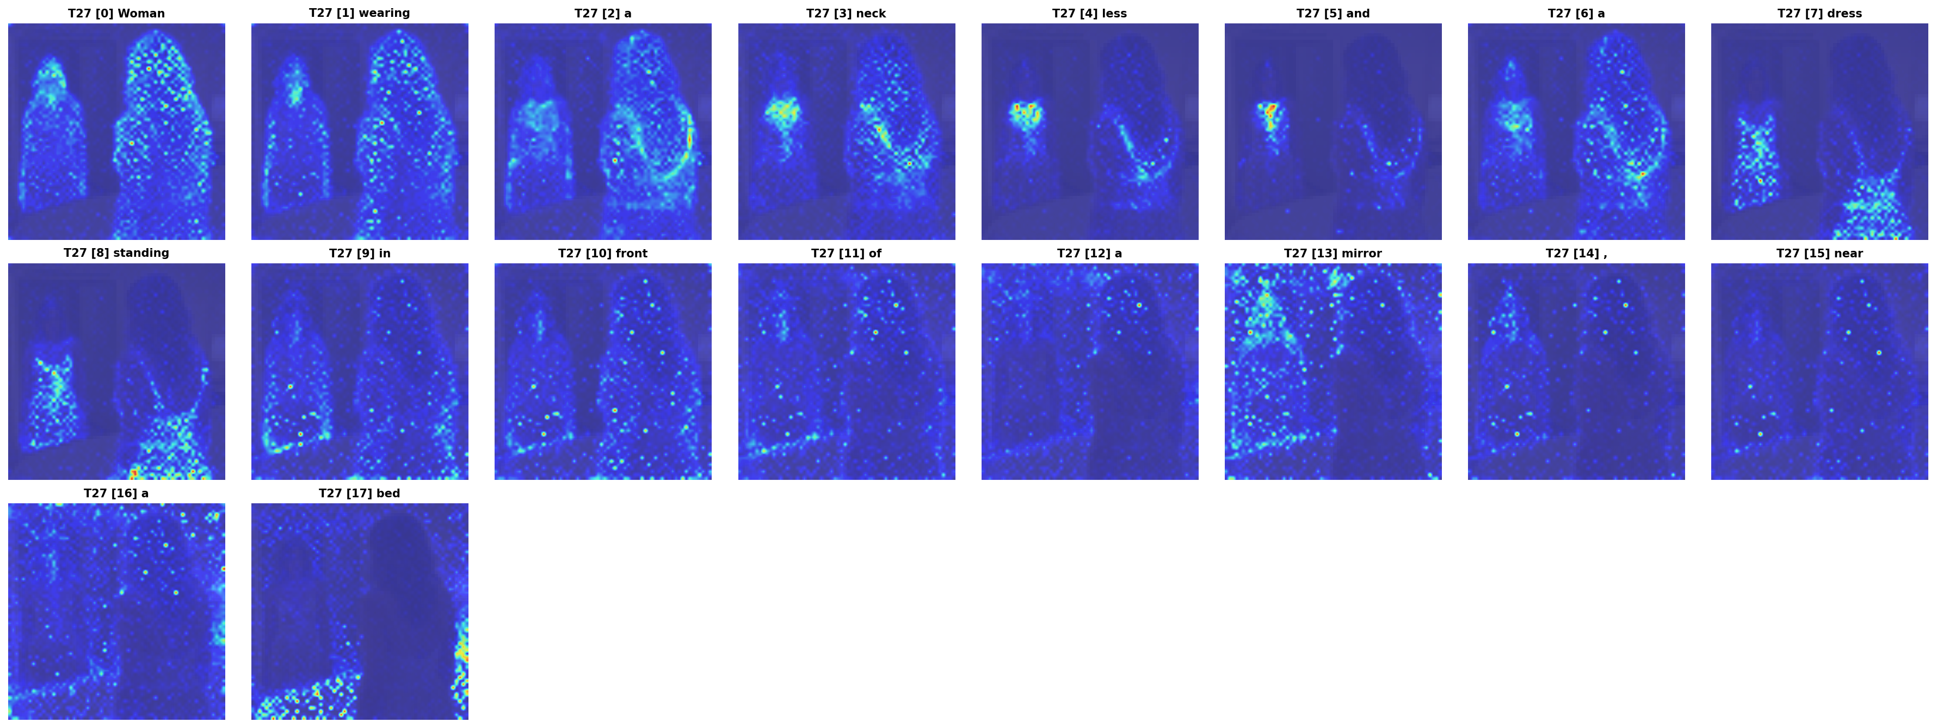
Experiment Results
BAGEL 모델에서 Q-K attention map 확인
EraseAnything에서 FLUX의 Self-Attention이 Cross attention처럼 토큰 별로 특정한 위치에 영향을 준다는 사실을 발견함.
BAGEL 모델에서도 동일 현상이 발생하는지 확인하면, W_q, W_k를 대상으로 concept erasing을 진행하는 근거를 확보할 수 있음.
"Woman wearing a neckless and a dress standing in front of a mirror, near a bed”
(timestep 27, layer 13)

Slide 9

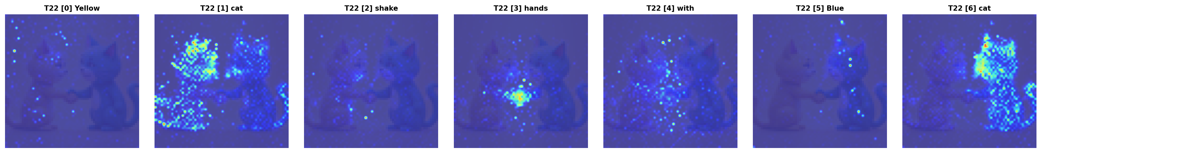
Experiment Results
BAGEL 모델에서 Q-K attention map 확인
EraseAnything에서 FLUX의 Self-Attention이 Cross attention처럼 토큰 별로 특정한 위치에 영향을 준다는 사실을 발견함.
BAGEL 모델에서도 동일 현상이 발생하는지 확인하면, W_q, W_k를 대상으로 concept erasing을 진행하는 근거를 확보할 수 있음.
TODO: QK-V attention map
“Yellow cat shake hands with Blue cat”
(timestep 27, layer 13)

Slide 10
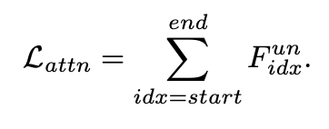
Hypothesis 1
기존 EraseAnything 방식의 문제:
txt
img
txt
img
Mickey mouse

Slide 11
Hypothesis 1
기존 EraseAnything 방식의 문제: Txt-txt도 같이 줄어듦
FLUX는 image generation-only라 텍스트 생성 능력이 필요없음
BAGEL 모델은 txt-txt attn 부분이 reasoning backbone 역할. 그대로 갖다 쓰면 text-generation task에서 catastrophic unlearning 위험?
txt
img
txt
img
Mickey mouse

Slide 12
Hypothesis 2
기존 EraseAnything 방식의 문제: Txt-txt도 같이 줄어듦
FLUX는 image generation-only라 텍스트 생성 능력이 필요없음
BAGEL 모델은 txt-txt attn 부분이 reasoning backbone 역할. 그대로 갖다 쓰면 text-generation task에서 catastrophic unlearning 위험?
txt
img
txt
img
Mickey mouse

Slide 13
Hypothesis
일반 모드에서 특정 개념을 지웠다면, Think 모드에서 복원하여 생성될까?
“Mickey Mouse” think 예시
Self-attention 단계에서 이 개념을 지운다면, shared 구조이기 때문에 추정 자체를 지울 때 target으로 한 concept 방향으로 진행하는가? 혹은 구체적 개념까지는 erasing되지 못해서 살아날까?
되살아난다면, 하나의 개념을 UMM 모델의 개념 공간에서 task 측면에서, 개념 측면에서 entangle하는 것이 연구 목표가 될 것
(SPEED에서도 “Mickey Mouse”의 “summary token”을 가지고 지움. 계산량/표현력 이슈로 모든 단어 토큰의 합/평균을 사용하지 않음)
어떤 모듈이 최적의 수정 지점인가
Self-Attention 단계의 W_k, W_v
FFN ← (Transformer Feed-Forward Layers Are Key-Value Memories, ACL 2021)
[ 전체 모델(BAGEL)에서의 비율 (only GEN or UNG / both side) ]
(A) Attention 전체 비율 : 0.05 % / 0.10 %
(B) k_proj + v_proj 비율 : 0.007 % / 0.014 %
(C) v_proj 비율 : 0.0036 % / 0.007 %
(D) FFN 전체 비율 : 0.4 % / 0.8 %
(E) FFN down_proj 비율 : 0.134 % / 0.26 %
Thinking: <think>
The model should generate an image of Mickey Mouse, a famous cartoon character with large round ears, a cheerful expression, and a red bow tie.
Here’s the full, detailed prompt: A vibrant and cheerful depiction of Mickey Mouse, featuring his iconic large round ears, a bright and friendly expression, and a classic red bow tie. The image should be highly detailed and colorful, with a clean and polished cartoon style, set against a simple white background to emphasize the character. The lighting is soft and even, creating a warm and inviting atmosphere, with no distractions or additional elements in the scene.
</think>

Slide 14
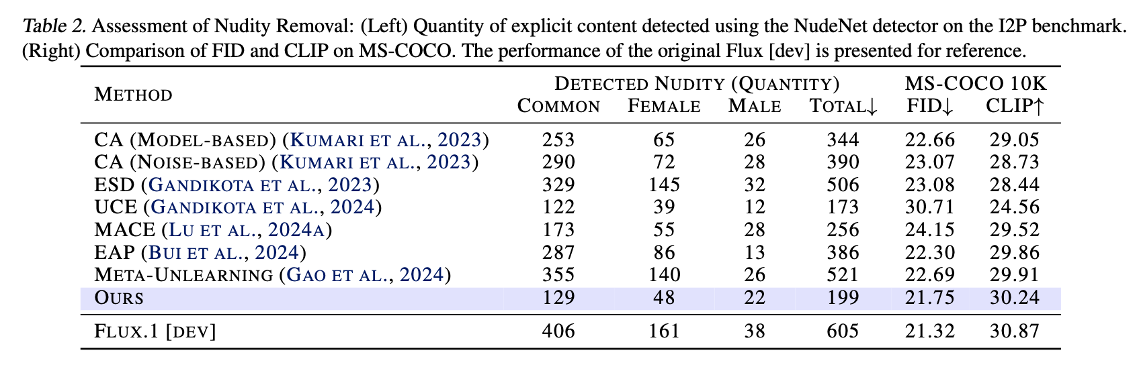
On-going Implementation
* EraseAnything: Enabling Concept Erasure in Rectified Flow Transformers (ICML, 2025)
BAGEL Generation With Think
BAGEL Generation Without Think

Slide 15
* Plan
Memorization
Previous Works cannot resolve this phenomenon?
More Training Experiments on More Classes/Instances
‘dvddog’
Temporal Analysis
Compared btw ‘Dominating’ and ‘Others’
Should be Compared btw ‘Dominanting’ and ‘Dominated’
Additional Experiments on SD2.1 (All Analysis Part)
Fine-tuning experiment
Focus score
Temporal Analysis
Head Ablation
Strengthen the minor argument
Concept Erasing in UMM
Apply baseline Methods: SPEED, EraseAnything, …
Discover “Think” mode
Milestone
Rebuttal (Jan, 22, 2026) – 3 weeks
Concept Erasing in UMM
* scholarship

Slide 16
CVPR 2026 Submission
Previous Works cannot resolve this phenomenon?
More Training Experiments on More Classes/Instances
‘dvddog’ and more
Does size of the content in training data matters?
Temporal Analysis
Compared btw ‘Dominating’ and ‘Others’
Should be Compared btw ‘Dominanting’ and ‘Dominated’
Additional Experiments on SD2.1 (All Analysis Part)
Fine-tuning experiment
Focus score
Temporal Analysis
Head Ablation
Strengthen the minor argument
intra-category cosine distances – Try more training images
Head ablation - Others 카테고리에 대한 추가 분석
Dominated Token에 대해서 Layer 7를 추적하는 이유
Ablation Study (epsilon, LPIPS/SSCD threshold)

